Slide 1
PCB Designing
By: Prabhnoor Kaur
Group-1
C0760731

Slide 2
PCB
PCBs or printed circuit boards serve as the backbone of any design industry, allowing you to connect passive components, active components, and embedded devices together, into a specific form to fit the design need. A number of stages are involved in proper PCB fabrications which include designing, layout, routing, etching & troubleshooting.

Slide 3
Easy EDA
EDA stands for electronics design automation, and EasyEDA is a tool that will help you design the desired PCB quickly and effortlessly.
EasyEDA is the perfect PCB design software for beginners. Regardless of the effect you want to achieve with your board, you will find this tool a convenient solution for your design.
It’s compatible with windows, mac, linux, as long as there is one browser on the OS and connecting to the network.
The software is free, and you can run it online or download it.

Slide 4
Easy EDA
It offers Simple, Easier, Friendly, and Powerful general drawing capabilities along with Real-time Team Cooperation & Integrated PCB Fabrication services with the collaboration of JLCPCB.
JLCPCB is the foremost PCB prototype & manufacturing company in china, providing us with the best service we have ever experienced regarding (Quality, Price Service & Time).

Slide 5
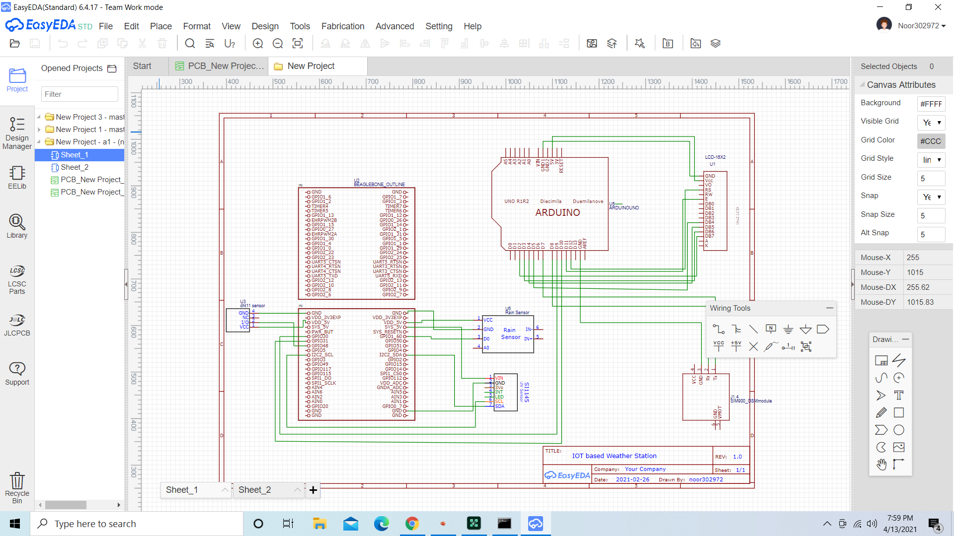

Slide 6
PCB design and layout
The schematic will serve as a blueprint for laying out the traces and placing the components on the PCB.
It’s a good idea to label the symbols. The labels will be transferred over to the PCB layout and eventually be printed on the finished PCB. Each symbol has a name (R1, R2, C1, C2 etc.) and value (10 μF, 100 Ω, etc.) that can be edited by clicking on the label.

Slide 7
PCB design and layout
1) Convert your schematic to a PCB.
Once you’re done with your schematic, you could click on “Convert project to PCB”.
The footprints associated with each schematic symbol will be automatically transferred to the PCB editor.
2) You’ll see the PCB Layout screen with your circuit into a rough PCB layout outside a rectangular board outline.

Slide 8
Cont....
3) After that, place all components within board outline.
4) After Placing the components, drag and drop the components to the spots where you want them to be.
Also make sure to leave some extra space between components because leaving some space will make the soldering a lot easier.

Slide 9
Cont....
5) After that, run the Auto router by selecting the router option from the drop down menu.
6) After completing your design, select the 3D view from the dropdown menu to view the finished PCB.
7) Generate gerber file:When you want to generate the gerber file from the layout editor. A new browser tab will open to download the gerber files and to offer you manufacturing the PCB using JLCPCB service.

Slide 10
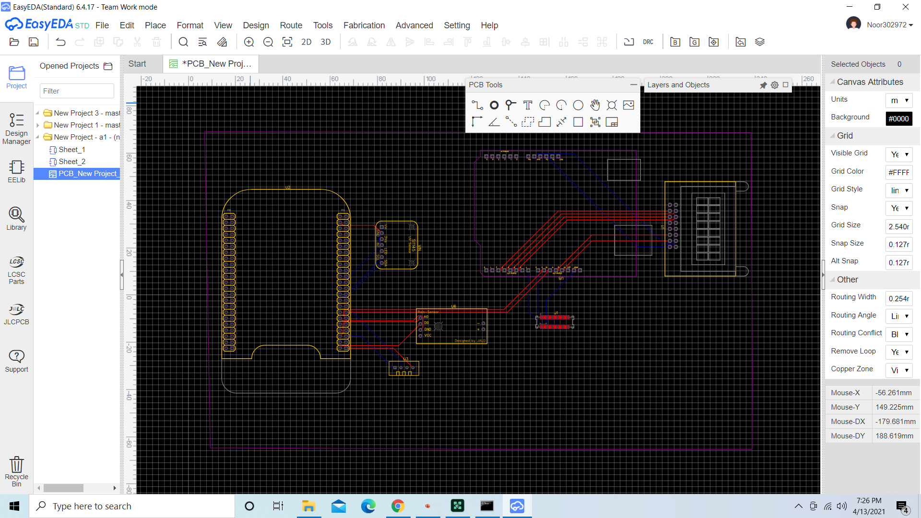

Slide 11
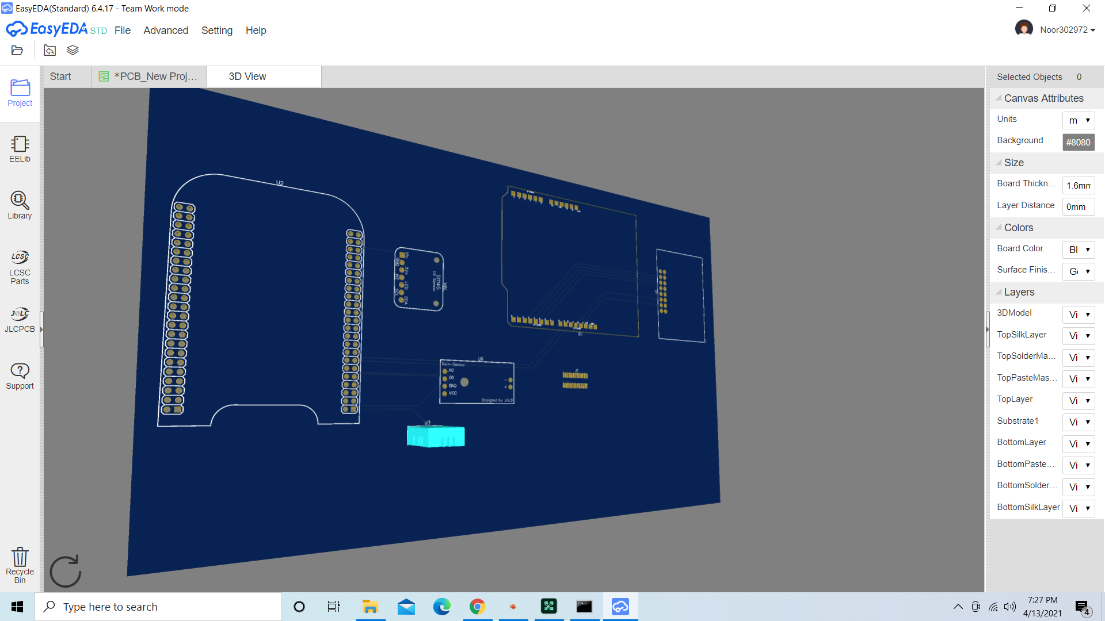

Slide 12
Cont....
The thin blue lines connecting the components. These are called ratsnest lines. Ratsnest lines are virtual wires that represent the connections between components. They show you where you need to route the traces according to the wiring connections you created in your schematic.

Slide 13
Cont.....
The last thing to do before placing the order is to run a design rule check. A design rule check will tell you if any components overlap or if traces are routed too close together. The design rule check can be found by clicking the “Design Manager” button.
Items that fail the design rule check will be listed below the “DRC Errors” folder. If you click on one of the errors, the problem trace or component will be highlighted in the PCB view.

Slide 14
Ordering the PCB
Start by clicking the “Fabrication Output” button in the top menu of the PCB editor.
This will take you to another screen where you can choose the options for your PCB order.
You can select the number of PCBs you want to order, the number of copper layers, the PCB thickness, copper weight, and even the PCB color.
You can also download your PCB’s Gerber files if you want to send them to a different manufacturer:

Slide 15
Gerber files
Gerber files are a set of image files that contain the patterns used to manufacture your PCB. All of the files are compressed into a single .zip file. There is a separate file for the copper traces, silk screen, and locations of drill holes and vias.

Slide 16
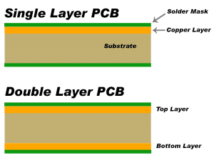
PCB LAYERS
Larger circuits can be difficult to design on a single layer PCB because it’s hard to route the traces without intersecting one another. You might need to use two copper layers, with traces routed on both sides of the PCB.

Slide 17
Cont....
To route the traces there are 2 different ways to perform this step. The easiest is to use the “Auto Router” function.
You can switch to the opposite layer (top/bottom) if you have to cross lines. If you have to switch to another layer for a SMD component you have to use a “via” which can also be found in the tools menu. A via is basically a copper connection between multiple layers.
EasyEDA supports up to 6 layer PCBs by default.

Slide 18
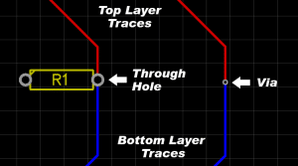
Cont....
The traces on one layer can be connected to the other layer with a via. A via is a copper plated hole in the PCB that electrically connects the top layer to the bottom layer.

Slide 19

Cont....
Most of the copper traces bend at 45° angles. One reason for this is that 45° angles shorten the electrical path between components compared to 90° angles. Another reason is that high speed logic signals can get reflected off the back of the angle, causing interference.

Slide 20
Footprint
Each schematic symbol you use needs to have a PCB footprint associated with it. The PCB footprint will define the component’s physical dimensions and placement of the copper pads or through holes.
Searching footprints is the same as searching symbols by using Library in the Schematic. You can place the selected footprints in the canvas after the search.

Slide 21
DRC
While drawing the PCB, several mistakes can occur (i.e. overlaps, very near objects .. etc).
A good thing about EasyEDA’s DRC (Design Rule Check) that it does the check in real-time while drawing, which is a very handy feature can’t be found in Eagle CAD.
Running a DRC is almost the last step in checking your PCB design before you generate Gerber and Drill files for board manufacture ready to place your order for a finished PCB.

Slide 22
Cont....
Some example of DRC’s in the design include:
The spacing between the traces, and between the trace and pads, through holes.
Design of the key signal lines. Trace length and guard wire length along with the required separation of input and output lines.
Modifying undesirable lines.
Via size and spacing.

Slide 23
Features
1) Align Tool
With one click you can make the selected components align vertically or horizontally with other many options.
2) Modules Many PCB CAD tools, like Eagle CAD, have added this feature recently. This feature allows designers to reuse chunks of circuits later, where some common parts of the design (module) are needed in most circuits. So modules can be added in one step instead of designing it each time. This applies for schematic and PCB.

Slide 24
Cont....
API/Scripts
No matter how the programme is full of tools, a user may still want to do something tools can’t do. EasyEDA provides the mechanism to write your own tools in form of an extension or a simple script.
Autorouter
Like any other autorouter tool, you need to set some configuration before the routing stage and then run it.
There are two options to use online autorouter or to download the tool on your PC.It is adviced to use the local one as the online autorouter may be overloaded when many users use it which causes a failure in the output.

Slide 25
Features
Import from Eagle CAD Another cool feature, which many CAD tools provide, is to import the design from another file type. EasyEDA supports importing files from Eagle CAD and even Altium.
Sharing and Versions Control System Features
First, you can add another member to view or to edit the project.
Second, EasyEDA allows you to create teams. Each team has members and projects. After you create the team, you invite members to it.
In order to show and edit team’s projects, you must switch to your team profile first.

Slide 26
Cont....
PCB Fabrication and Components Purchase Service
Users can order the BOM and manufacture the PCB by a partner or a sister company. EasyEDA is part of another group consists of an electronic parts distributor called LCSC and a PCB factory called JLCPCB.

Slide 27
Advantages
The tool is incredibly easy to use and beginner-friendly.
A massive library of components that allows you to draw schematics quickly.
You can download a desktop client for Windows, Linux, and Mac. But if you don’t want to install it on your PC, you can also run a free Online Editor with the same functions.
EasyEDA allows you to import schematic and other files from KiCad, Eagle,align tool, modules feature, APIs, offline autorouter and other tools.

Slide 28
Disadvantages
It is a relatively new software that hasn’t been around as long as KiCad.

Slide 29
References
https://docs.easyeda.com/en/Introduction/PCB-Layout/index.html
https://easyeda.com/feather/PCB_Layout_Tutorial-LztL3XfwO
https://www.instructables.com/How-to-Make-a-Circuit-Board-With-EasyEDA/
https://www.circuitbasics.com/make-custom-pcb/

Slide 30
References
https://www.wellpcb.com/easyeda.html
https://circuits-diy.com/complete-pcb-designing-tutorial-using-easyeda-pcb-design-tool/
https://www.youtube.com/watch?v=bwDQtnaaywg&list=PLE1qlkmzXrwSp1nBlkF8qCC2p2mUKT9Y0&index=4

